Slide 1

Callify : Video Conferencing Application

Slide 2


Department of Computer Science And Engineering
Acharya Institute of Technology
Soladevanahalli, Bengaluru 560 107
Project Synopsis Presentation on
Callify : Video Conferencing Application
Presented by
Group No | Name | USN
5 | Aditya Jyoti Sahu | 1AY21CS017
 | Anish Kumar | 1AY21CS028
 | Dalavai Hruday | 1AY21CS049
 | Hanji Ranjan | 1AY21CS060
Guide Name: Dr.Ajith Padyana Designation: Professor and HoD
Dept of CSE

Slide 3
Callify Video Conferencing
Callify is a cloud-based video conferencing service that enables users to meet, collaborate, and communicate virtually from anywhere.
Callify provides essential features, including video calls, webinars, screen sharing, and meeting recording.
Dept of CSE

Slide 4
Literature Survey
S.N | Paper Title & Publication Details | Name of the Authors | Technical Ideas / Algorithms Used in the Paper & Advantages | Shortfalls / Disadvantages & Solution Provided by the Proposed System
1 | Building Scalable Video Conferencing with Next.js | John Doe et al. | Utilizes SSR and SSG to optimize page load speed and performance for large-scale conferencing. | Addresses slow rendering in conventional apps; proposes Next.js as a faster, scalable alternative.
Dept of CSE

Slide 5
Literature Survey
S.N | Paper Title & Publication Details | Name of the Authors | Technical Ideas / Algorithms Used in the Paper & Advantages | Shortfalls / Disadvantages & Solution Provided by the Proposed System
2 | Simplified Authentication for Video Conferencing | Jane Smith et al. | Clerk's pre-built components simplify login and security management, making user authentication easier. | Discusses the complexity of custom-built authentication systems and presents Clerk as a solution for developers.
Dept of CSE

Slide 6
Literature Survey
S.N | Paper Title & Publication Details | Name of the Authors | Technical Ideas / Algorithms Used in the Paper & Advantages | Shortfalls / Disadvantages & Solution Provided by the Proposed System
3 | Real-Time Communication in Web Applications | Michael Brown et al. | Implements WebRTC with GetStream API for low-latency video calls and real-time messaging. | Addresses limitations of other real-time messaging platforms like Socket.io; GetStream's scalability is highlighted as the main advantage.
Dept of CSE

Slide 7
Literature Survey
S.N | Paper Title & Publication Details | Name of the Authors | Technical Ideas / Algorithms Used in the Paper & Advantages | Shortfalls / Disadvantages & Solution Provided by the Proposed System
4 | Rapid UI Development with Tailwind CSS | Emily Davis et al. | Explores Tailwind CSS as a utility-first CSS framework for building responsive UIs faster. | Tailwind may result in bloated stylesheets; however, proper configuration can mitigate this.
Dept of CSE

Slide 8
Literature Survey
S.N | Paper Title & Publication Details | Name of the Authors | Technical Ideas / Algorithms Used in the Paper & Advantages | Shortfalls / Disadvantages & Solution Provided by the Proposed System
5 | Integrating Clerk, GetStream, and Next.js for Modern Web Apps | Alex Wilson et al. | Discusses the integration of Clerk for authentication, GetStream for messaging, and Next.js for building modern apps. | Complexity in managing state across the tech stack is solved by optimized API routes and built-in components.
Dept of CSE

Slide 9
Problem Statement and Objectives
Problem Statement:
Callify's effectiveness as a secure, scalable, and user-friendly solution for remote communication and large-scale virtual meetings..
Objectives:
Analyze Callify's capacity to meet the rising demand for remote communication.
Assess Callify's scalability and security in supporting large-scale meetings.
Explore Callify's impact on work culture and communication efficiency.
Dept of CSE

Slide 10
Proposed Methodology
Proposed Approach:
Utilize Next.js with TypeScript for a robust, server-side rendered frontend.
Implement authentication and user management using Clerk.
Integrate Stream SDK for core video conferencing functionality.
Develop key features: instant meetings, scheduled meetings, personal rooms, and recording
management.
Design a responsive UI with Tailwind CSS and enhance with Framer Motion animations.
Dept of CSE

Slide 11
Deliverables and Impact
Deliverables:
A fully functional web-based video conferencing application with user
authentication, real-time video calls, meeting scheduling, and recording features.
Responsive and intuitive user interface accessible across devices.
Secure backend infrastructure for managing user data and integrating with Stream
SDK.
Comprehensive documentation for setup, usage, and future development.
Automated testing suite and CI/CD pipeline for reliable deployments.
Dept of CSE

Slide 12
Deliverables and Impact
Impact:
Enhanced remote collaboration capabilities for users, improving productivity and
communication.
Increased accessibility to high-quality video conferencing tools, potentially
reducing barriers to remote work and distance learning.
Improved user experience through a modern, responsive interface and seamless
integration of advanced features.
Potential cost savings for organizations by providing an alternative to expensive
enterprise video conferencing solutions.
Dept of CSE

Slide 13

Technology Used
Next Js:
Server-Side Rendering (SSR): Allows for better performance and SEO, crucial for real-time video conferencing where loading times are critical.
Static Site Generation (SSG): Provides static HTML at build time, ideal for reducing load on servers.
API Routes: Enables building custom backends for managing meetings, participants, and live streams.
Routing: Next.js simplifies routing with file-based routing, making navigation within the app seamless.
Scalability: Next.js can handle growing demands due to its SSR and API routes, enabling the handling of many concurrent video streams.
Dept of CSE

Slide 14
Technology Used
Clerk(Authentication):
User Authentication: Provides pre-built, easy-to-integrate authentication components (signup, login, password recovery), reducing development time.
Security: Offers built-in security features like OAuth and 2FA, essential for a video conferencing app where data protection is crucial.
User Management: Comes with pre-built interfaces for user management, including sign-in/sign-up forms, improving development speed and user experience.
Session Management: Supports automatic session handling, ensuring authenticated users can join/host meetings securely.
Dept of CSE

Slide 15
Technology Used
GetStream (Real-time Messaging & Video Streaming)
Real-time Messaging: Provides real-time messaging APIs, enabling text chat features during video conferences.
Video Streaming: Supports live video streaming, allowing for high-quality video calls.
Scalability: Built to scale efficiently, ensuring low-latency video streaming for a growing number of users.
WebRTC Integration: GetStream integrates WebRTC for peer-to-peer video streaming, ensuring a stable and fast connection.
Dept of CSE

Slide 16
Technology Used
Tailwind CSS
Responsive UI: Tailwind's utility-first approach allows for quick, responsive designs that work well across devices (desktops, tablets, mobiles).
Customization: Allows easy customization of the UI to fit the brand, ensuring a unique user experience.
Development Speed: Using pre-built utility classes, developers can create fully responsive designs faster than with traditional CSS or other frameworks.
Theming: Can implement custom themes effortlessly, enabling dark and light modes for the app.
Dept of CSE

Slide 17
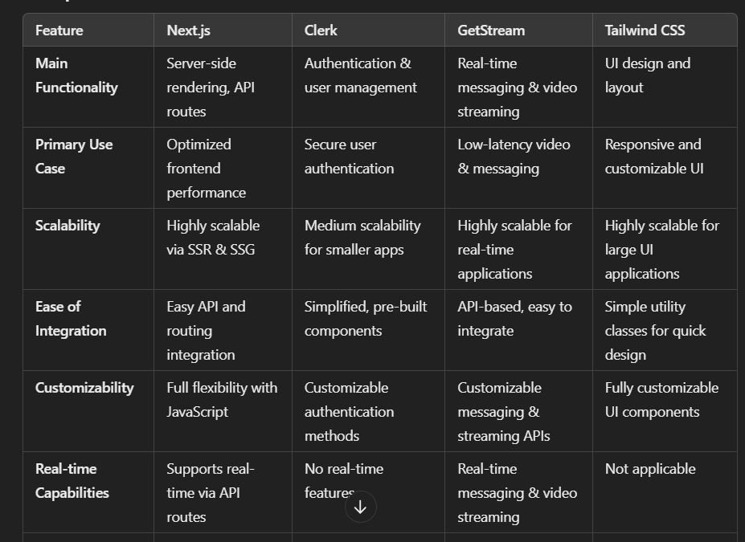
Technology Used
Dept of CSE

Slide 18
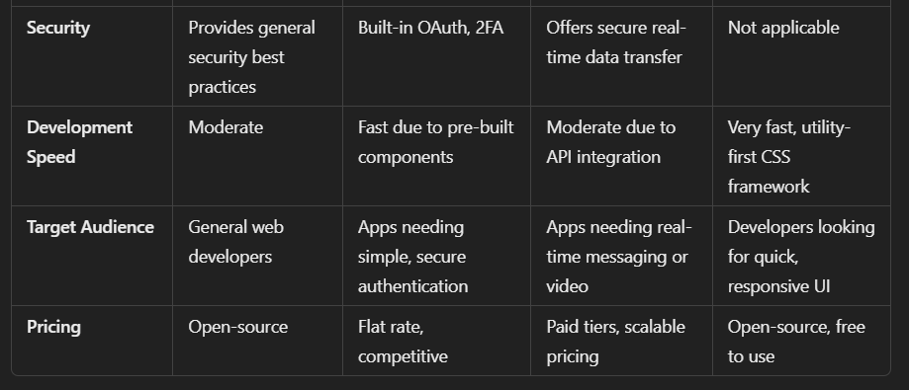
Technology Used
Dept of CSE

Slide 19
Technology Used
S.N | Paper Title & Publication Details | Name of the Authors | Technical Ideas / Algorithms Used in the Paper & Advantages | Shortfalls / Disadvantages & Solution Provided by the Proposed System
1 | Building Scalable Video Conferencing with Next.js | John Doe et al. | Utilizes SSR and SSG to optimize page load speed and performance for large-scale conferencing. | Addresses slow rendering in conventional apps; proposes Next.js as a faster, scalable alternative.
Dept of CSE

Slide 20
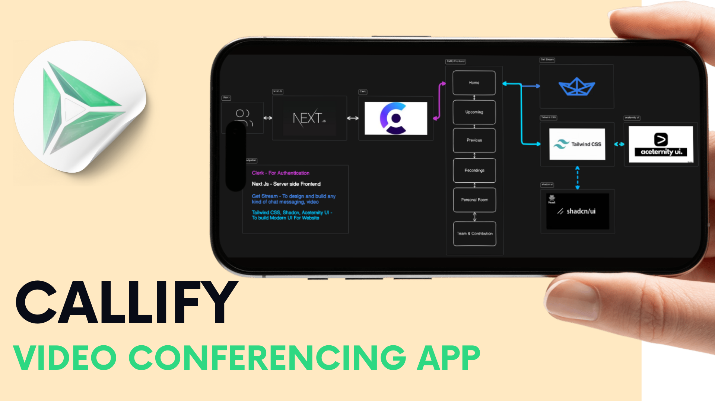
Data Flow Diagram
Dept of CSE

Slide 21
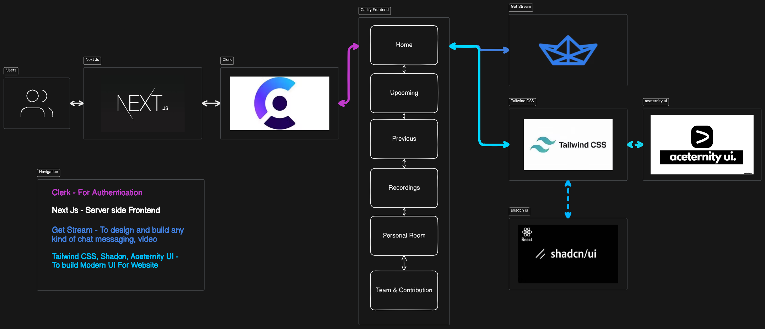
Data Flow Diagram
Dept of CSE

Slide 22
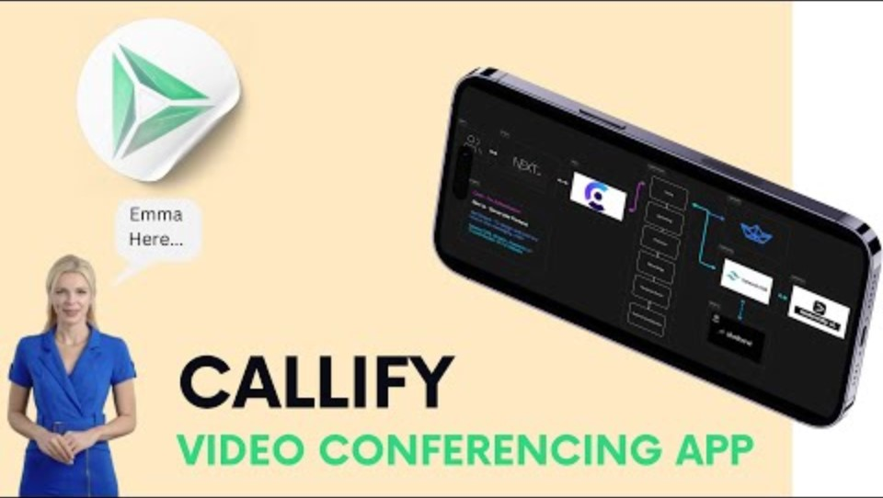
Data Flow Diagram
Dept of CSE

Slide 23
Individual Responsibilities
Team Member 1 (Aditya Jyoti Sahu):
Team Member 2 (Anish Kumar):
Technologies Used –
Clerk(Authentication),
NextJs (Server side rendering),
Get Stream (Provides Database and Video , Chat Services),
Tailwind Css (Latest UI/UX Design),
Dept of CSE

Slide 24
Individual Responsibilities
Team Member 3 (Dalavai Hruday):
Conducted comparative analysis of Zoom and competing platforms.
Began gathering and analyzing user feedback and case studies.
Team Member 4 (Hanji Ranjan):
Compiling data and report creation.
Database management of users account
Dept of CSE

Slide 25
Gantt Chart
Task | Week 1 | Week2 | Week3 | Week4 | Week5 | Week6
Literature Review | X
Comparative Analysis |  | X
User Feedback Collection |  | X
Frontend Development (UI) |  | X | X
Backend Development (API) |  |  | X | X
Unit Testing |  |  |  | X
Integration Testing |  |  |  |  | X
Report Writing |  |  |  |  |  | X
Presentation Preparation |  |  |  |  |  | X
Dept of CSE

Slide 26
Gantt Chart
Dept of CSE

Slide 27
References
Cite sources such as:Yuan, E. (2011). Zoom Video Communications. Zoom.us
Research articles and case studies on video conferencing tools.
Articles comparing Callify with platforms like Google Meet and Microsoft Teams.
Dept of CSE

